Slide 1



Solar magnetic fields:
diagnostics and applications
^{A. Asensio Ramos}
Instituto de Astrofísica de Canarias
aasensio.github.io/blog
@aasensior
github.com/aasensio

Slide 2
Solar magnetic fields:
diagnostics and applications
Lecture 3
Simplified diagnostics
Weak-field approximation
Strong-field approximation
Longitudinal and vector magnetographs
Bisector and center-of-gravity techniques
Unresolved fields
Asymmetries

Slide 3
Classical
Inference (pre 80’s)

Slide 4
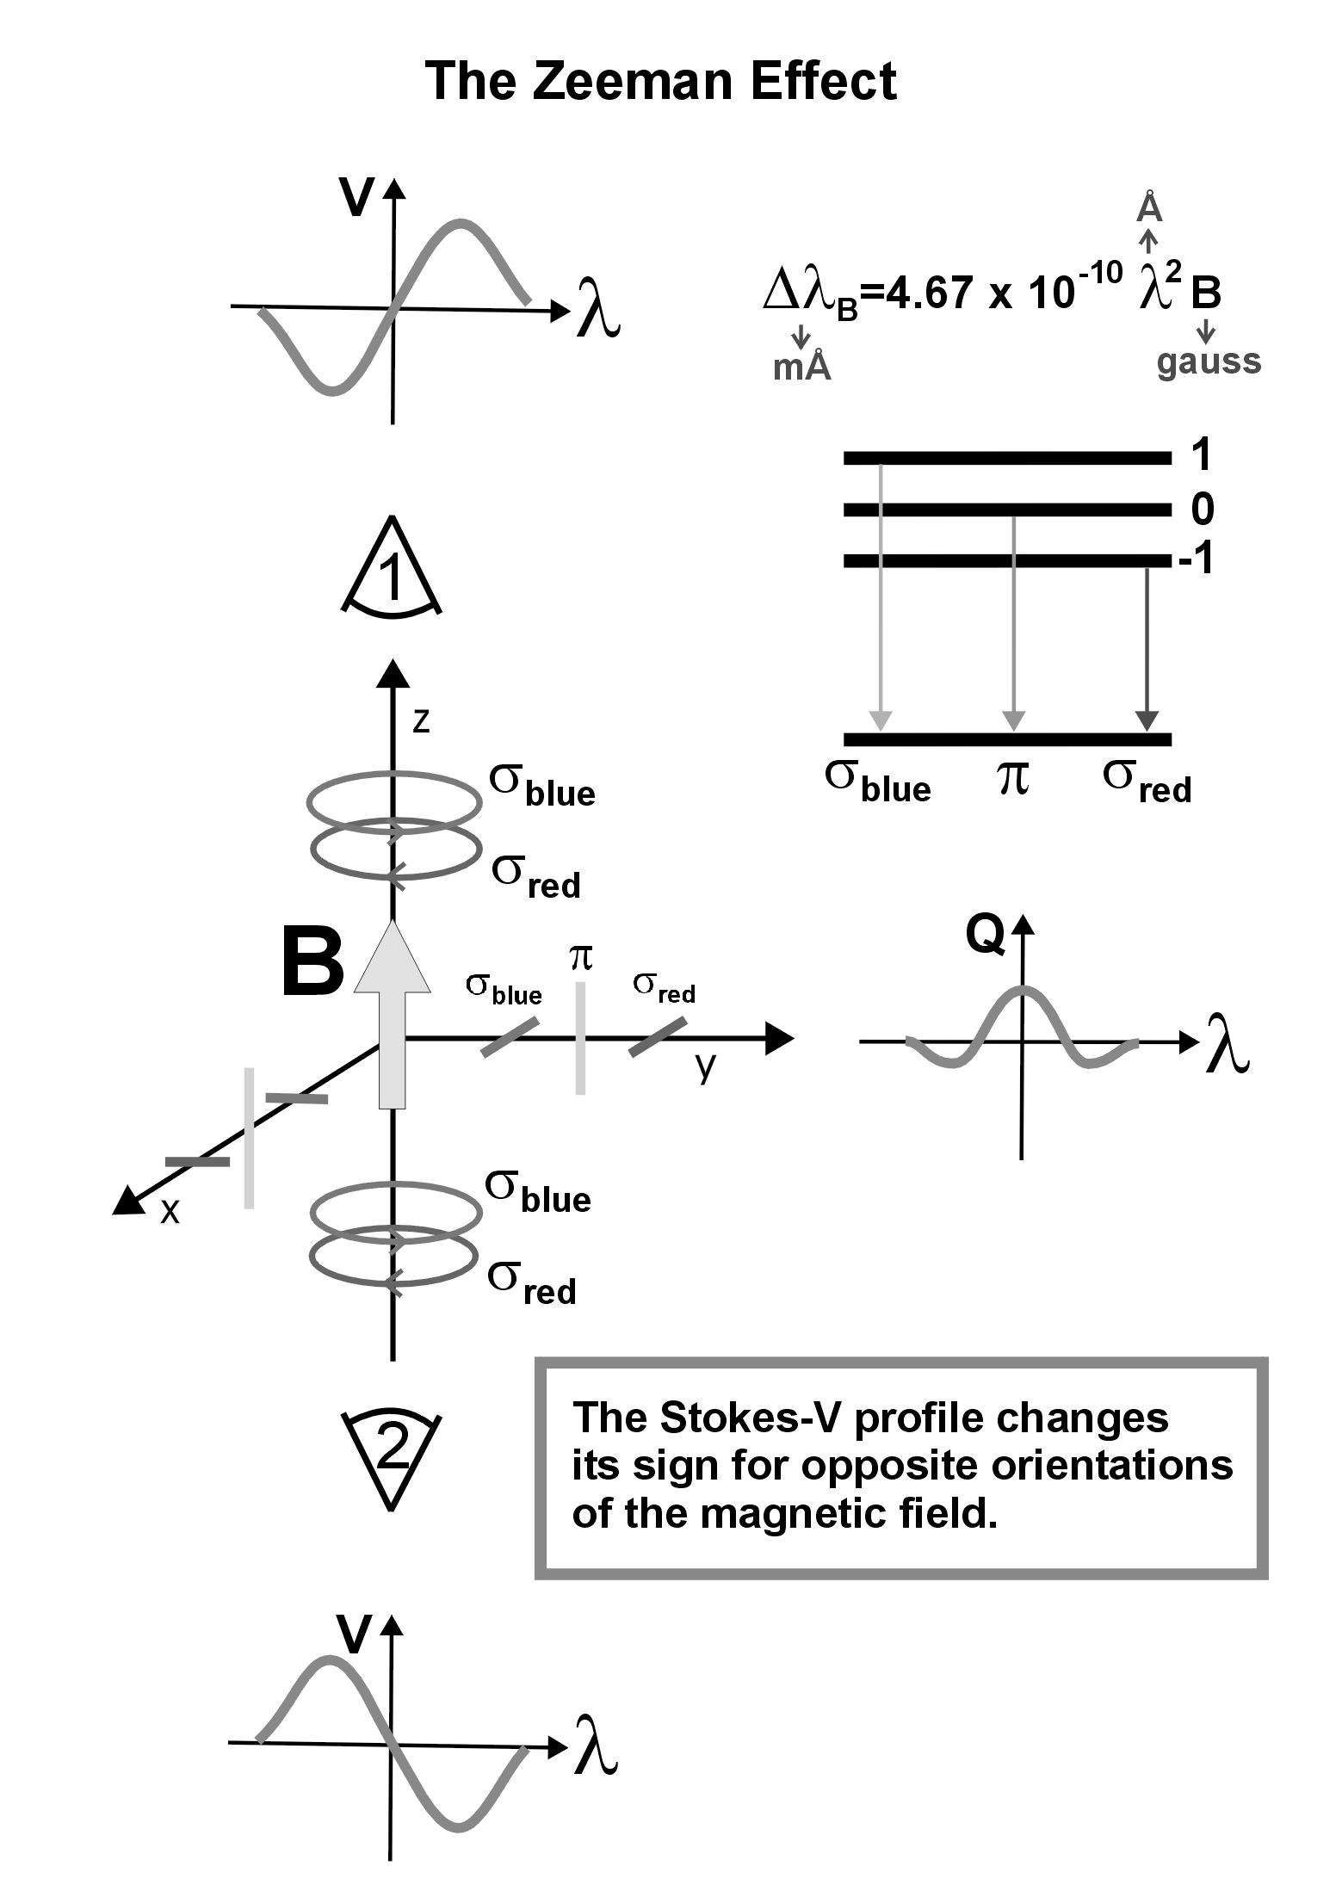

Slide 5

The radiative transfer equation

Slide 6




Weak-field approximation
If the magnetic field strength induces a Zeeman splitting much smaller than the Doppler width of the line
at optical wavelengths
for a typical Fe line
A series expansion of RT equation → different levels of approximation

Slide 7








RTE at zero order
Zero order
Boundary conditions

Slide 8
RTE at zero order
Zero order
I₀ is given by the unpolarized radiative transfer equation
Q₀=0, U₀=0, V₀=0
This zero order approximation is useless to explain
polarization profiles

Slide 9





RTE at first order
First order
The RTE for V₁ is equal to that of

Slide 10

Circular polarization is proportional to magnetic flux density
Zeeman
shift
(mÅ)
Line
wavelength
(Å)
Field
strength
(G)
This expression can be used to infer the magnetic
flux density B cos θ measuring Stokes V and I

Slide 11



To infer fields, use a linear fit

Slide 12


Linear polarization appears at second order
Second order
V₂=0
Rotating the reference system so that we minimize U
Useful to estimate the azimuth of the magnetic field

Slide 13


Effective Landé factors
Stokes V
Stokes Q

Slide 14
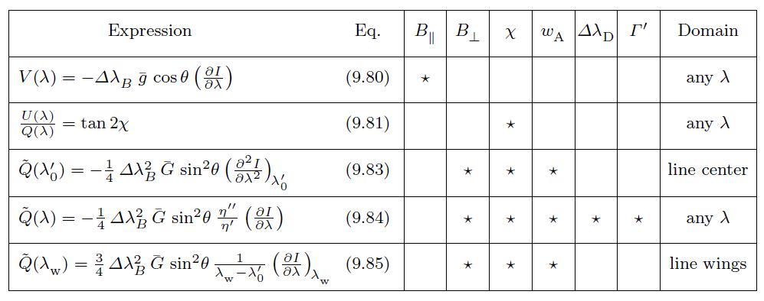
Conditions for the weak-field approximation to hold
Landi degl’Innocenti (2004)

Slide 15


Strong-field approximation
For IR lines, the splitting is much larger than the thermal
width for small fields
An Fe I line at 12 um for 300 G gives

Slide 16












Strong-field profiles
σ_{b}
π
σ_{r}

Slide 17


Strong-field: simple inference
Magnetic field intensity → measure component separation
Magnetic field azimuth → measure ratio of U and Q in σ or π components
Magnetic field inclination → use V, Q and U in any σ component
But it is always better to do a real model fitting

Slide 18






Longitudinal magnetograph – Babcock (1953)
It is fundamentally based on the weak-field approximation
At first order
The calibration constant has to be computed for
the specific instrument and expected Stokes I profiles

Slide 19
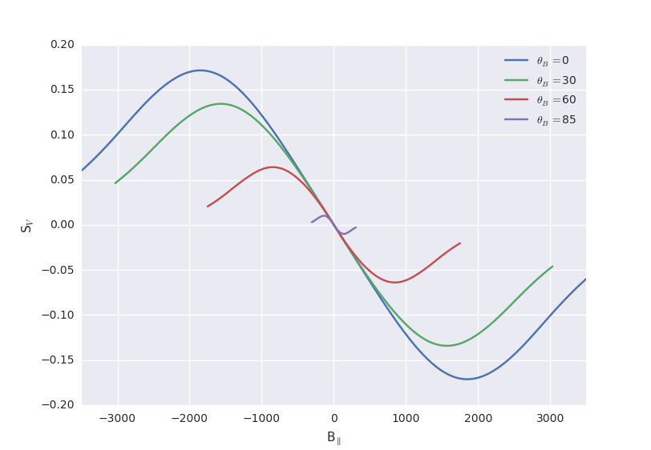
Longitudinal magnetograph – Babcock (1953)
Calibration issues (one single Stokes I profile)
Saturation effect

Slide 20





Vector magnetograph
At second order
The calibration constant has to be computed for
the specific instrument and expected Stokes I profiles

Slide 21
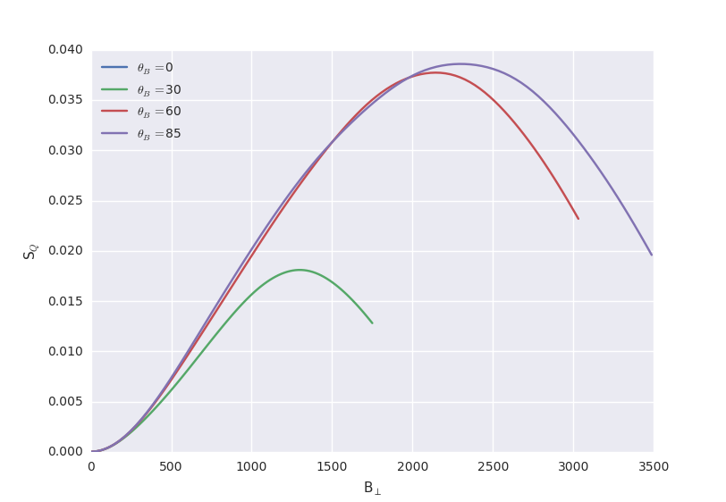
Vector magnetograph
Calibration issues (one single Stokes I profile)
Saturation effect

Slide 22




Bisector & center-of-gravity (Rayrole 1967; Semel 1967)
Left and right circular polarization
Compute the bisectors of I±
Compute the center-of-gravity of I±

Slide 23

Bisector & center-of-gravity (Rayrole 1967; Semel 1967)
Left and right circular polarization
If B is weak and the longitudinal component is independent
of depth, the cog and bisector techniques are correct
Have systematic errors
Provide only longitudinal component
Are not affected by saturation effects

Slide 24
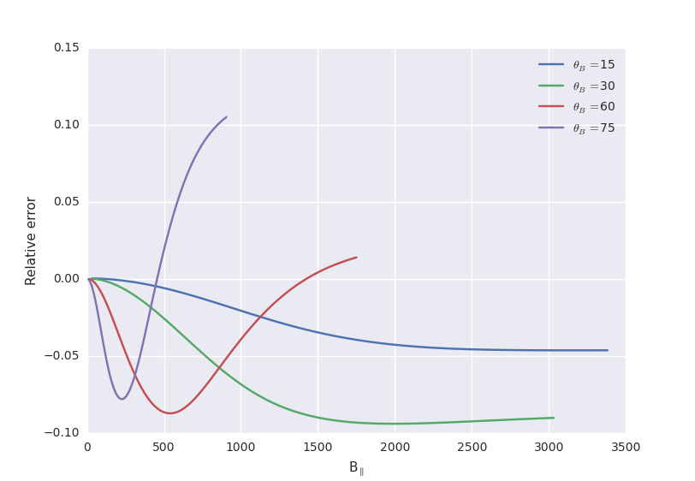
Bisector & center-of-gravity (Rayrole 1967; Semel 1967)

Slide 25
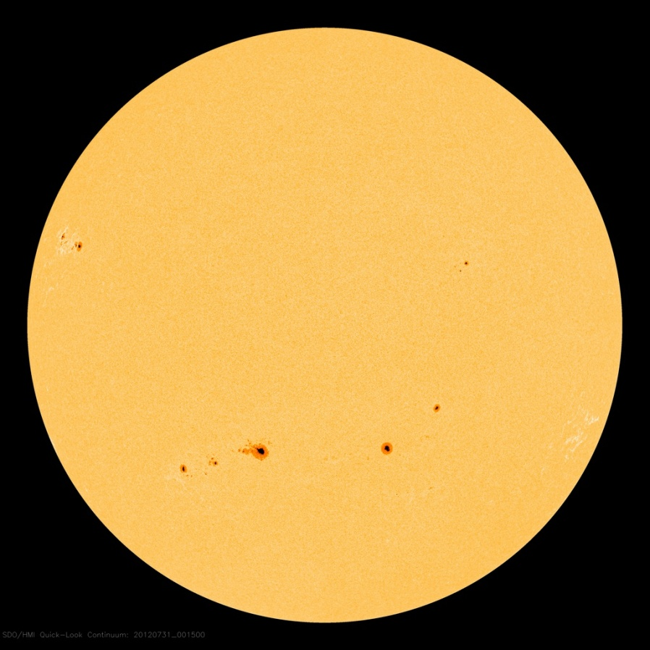
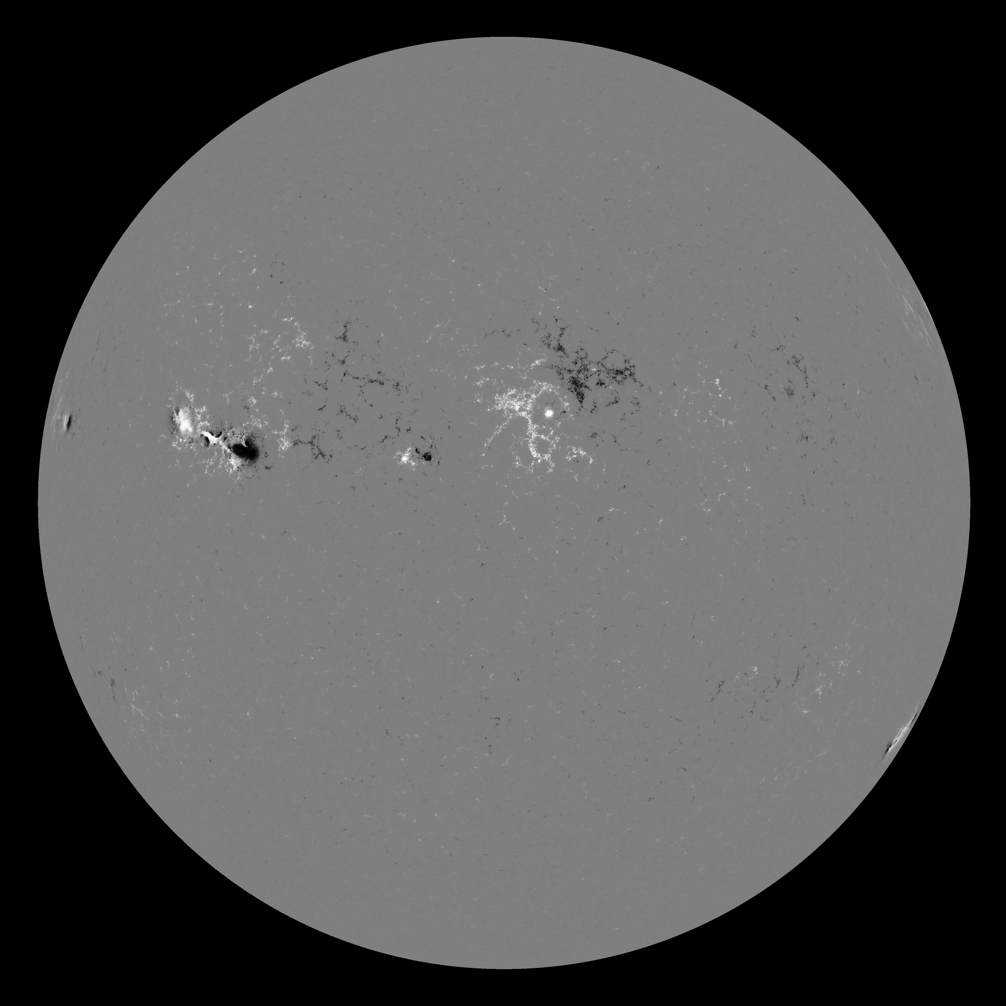
Unresolved fields
Magnetic fields are typically unresolved at this scale

Slide 26
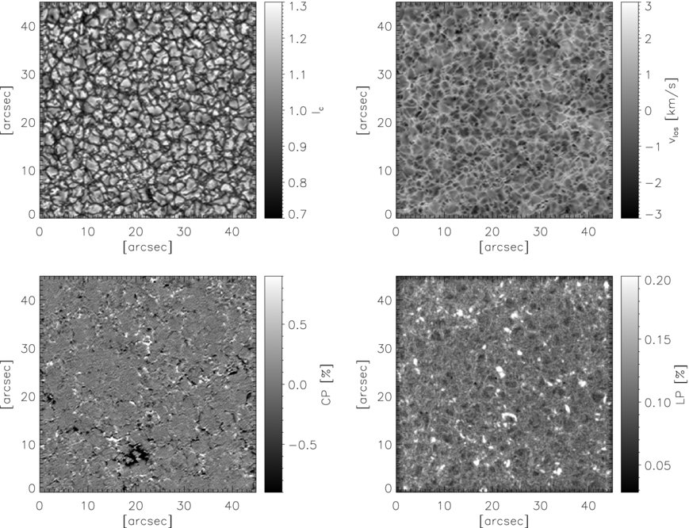
Unresolved fields
Martínez Pillet et al. (2010)
But they are also typically unresolved at our best current
observational capabilities

Slide 27


Unresolved fields – Longitudinal magnetograph
Local magnetograph signal
Actual observation

Slide 28





Unresolved fields – Longitudinal magnetograph
If the intensity profile is independent of P and
Longitudinal magnetograph measures the
«Flux of the magnetic field across the observed area»

Slide 29






Unresolved fields – Long. magnetograph – Filling factor
f: fraction filled with field
(1-f): field-free fraction

Slide 30


Unresolved fields – Vector magnetograph – Filling factor
f: fraction filled with field
(1-f): field-free fraction

Slide 31


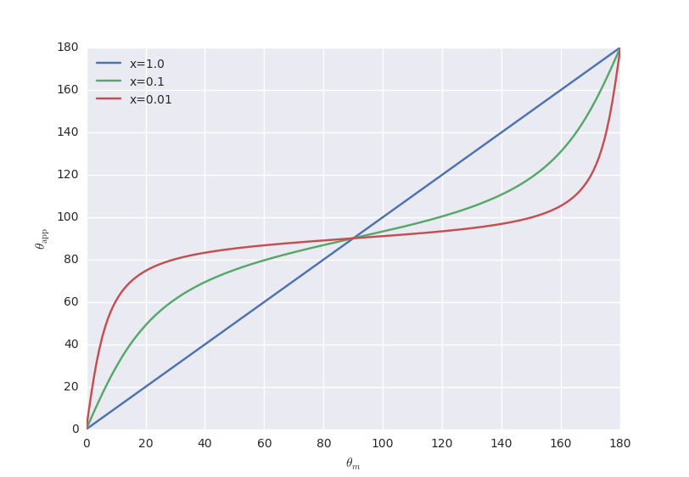
Unresolved fields – Inclination angle

Slide 32



Unresolved fields – Center of gravity
With the definition of the integrated line depression
The apparent fields turns out to be
With some renaming of variables, everything turns out
to be similar to what we get for the longitudinal magnetograph

Slide 33


Unresolved fields – The line ratio technique
The saturation regime occurs for each line at different field strengths
This can be used as an inference tool if one finds pairs of lines that:
Have exactly the same behavior with respect to the thermodynamics
Have different effective Landé factors
In the weak-field regime
When saturation occurs
Stenflo (1973)

Slide 34
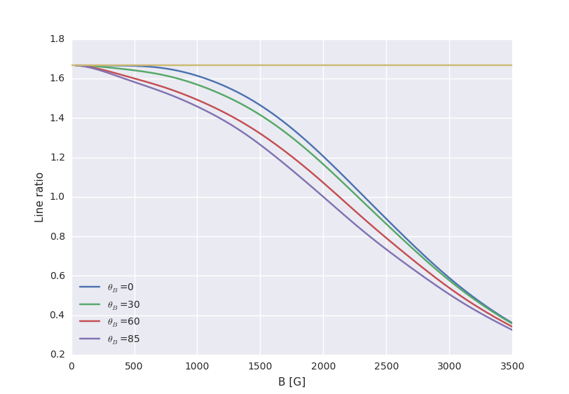
Unresolved fields – The line ratio technique

Slide 35
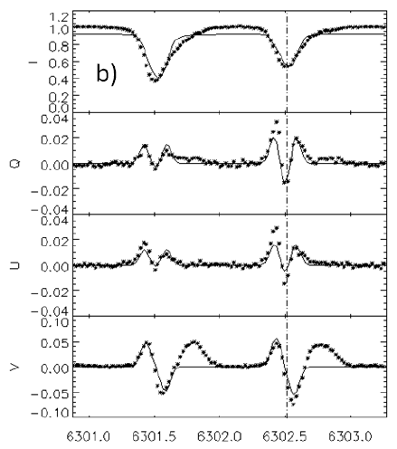
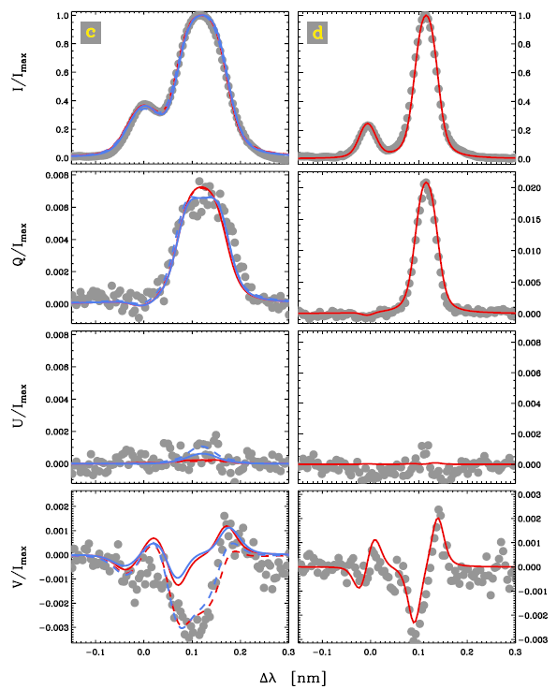
Asymmetries
Spectral lines are usually asymmetric
Zeeman effect (gradients)
Hanle effect (orientation)
Borrero (2012)
Martínez González et al. (2012)

Slide 36
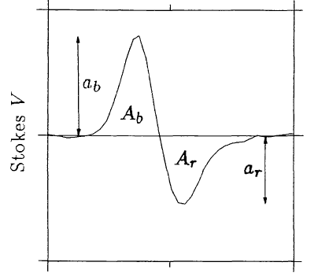



Characterizing asymmetries in Stokes V
Area asymmetry
Amplitude asymmetry

Slide 37

How can one generate asymmetries in Zeeman effect?
The Milne-Eddington solution to the RT equation gives symmetric profiles
At first order, area asymmetries are generated by B and v gradients
along the line-of-sight (see López Ariste 2002 for more details)
B
v
v=0
B=0
B=0
v=0
v
B

Slide 38
How can one generate asymmetries in Zeeman effect?
Area asymmetries → gradients along the line-of-sight
Amplitude asymmetries → can also be generated by other mechanisms

Slide 39
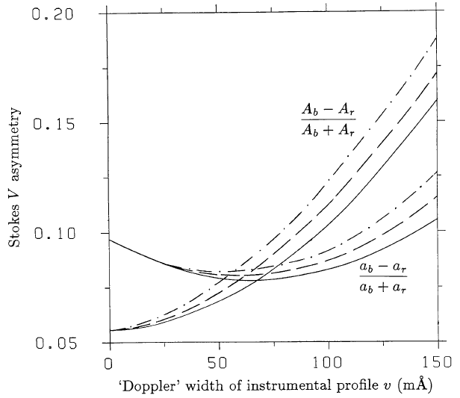
Measured asymmetries depend on the instrument
Solanki & Stenflo (1986)

Slide 40
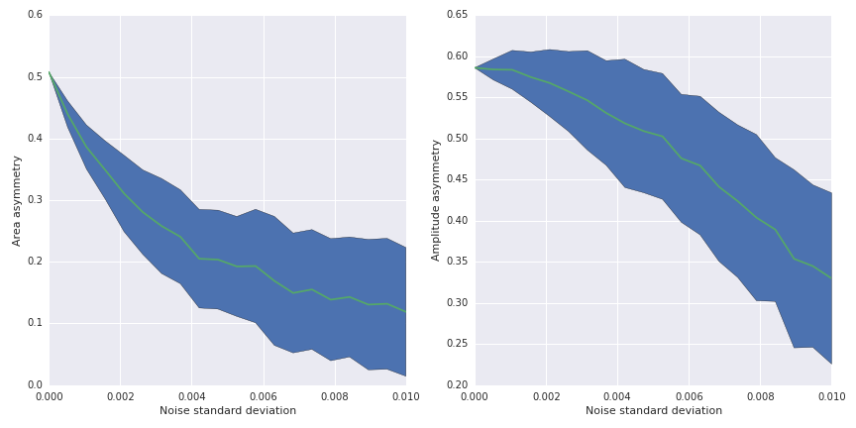
Be careful when measuring asymmetries in noisy profiles
Noise affects the measurement of asymmetries
Why??

Slide 41


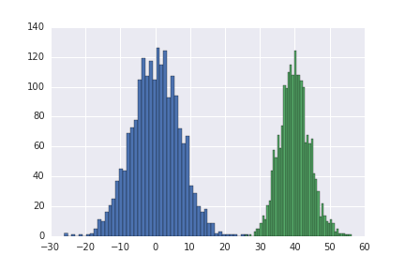
Explanation for area asymmetry
The integrand in the denominator is a non-negative function

Slide 42
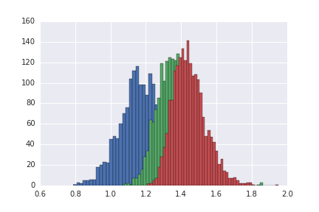
Explanation for amplitude asymmetry
Computing the amplitude with the max/min bias the result. The
final value depends on the number of wavelength points of the
profile

Slide 43
Area asymmetry in sunspots
The largest dA occurs in the limb-side penumbra with the same sign as the umbra’s blue lobe of Stokes V
The disk center-side penumbra shows dA of opposite sign and less magnitude
The penumbra of sunspots at disk center shows dA of the same sign to that of the limb-side penumbra
The explanation of these observations led to the development of several
models. The most successful to date is the embedded flux-tube model

Slide 44
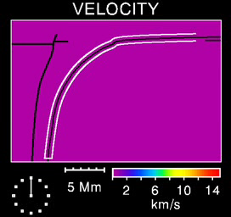
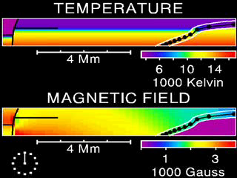
Area asymmetry in sunspots
Schlichenmaier et al. (1998)

Slide 45
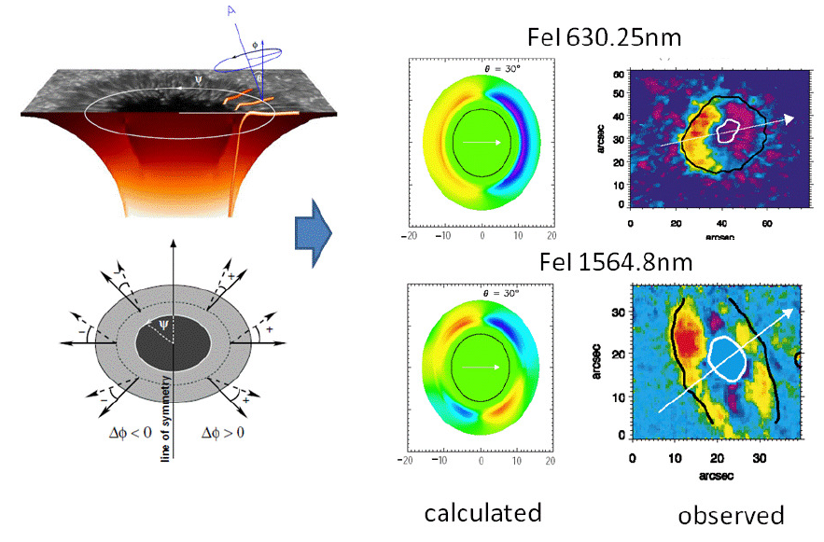
Area asymmetry in sunspots
Müller et al. (2002)

Slide 46
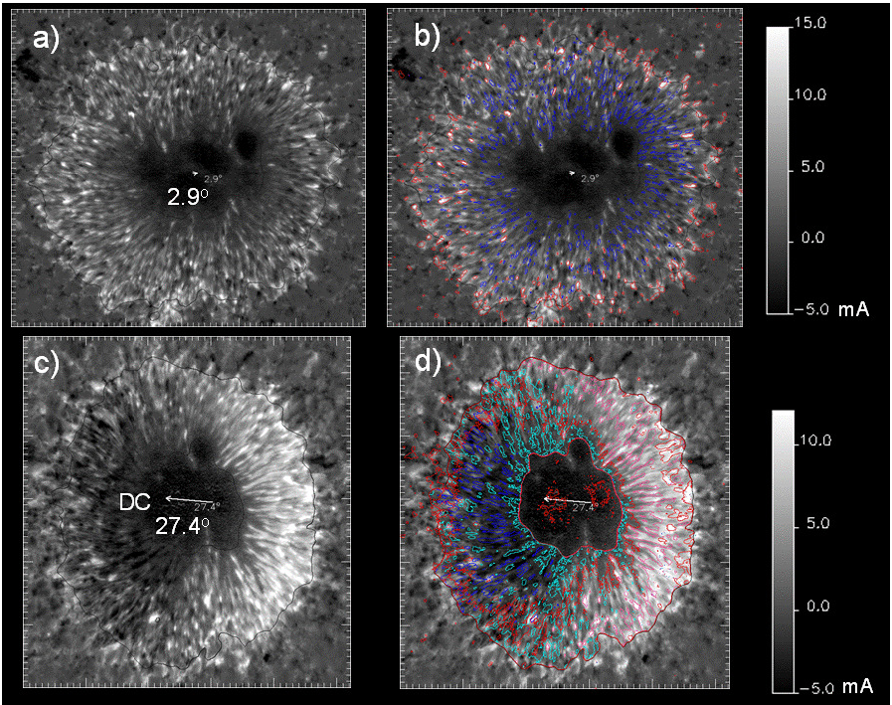
Area asymmetry in sunspots
Borrero (2012)

Slide 47
Final message
Simplified diagnostics were useful some decades ago
Some biases can be explained with them
Better fit the whole profile

